Slide 1
Quality and Cost
in the
True Performance Program
Capstone Project 2019 – Highmark Inc
Moe Wolf (MSHCPM ‘20)
Jonathan Dyer (MISM ‘19)
Jeremiah Humes (MSHCA ‘20)
Manjiri Kshirsagar (MSHCPM ‘20)
Faculty Advisor: Jim Jordan

Slide 2
Agenda
Problem Statement
Framework for Evaluation
Analysis
Recommendations

Slide 3



Objective
Which of the quality metrics are driving the cost outcomes?
What other quality metrics could potentially be added?
Investigate the state of value-based reimbursement programs.

Slide 4
Takeaways
VBR is early in the Continuous Improvement Cycle
More closely aligned measurement
Majority of progress has been made in cost measurement
Complexity of the program inhibits physician engagement
Missing a consistent, repeatable evaluation method

Slide 5


Program Evaluation Framework
What is it?
Industry standard method for assessment
Systematic approach to improve or affirm success of a program
Why did we choose it?
Eliminate the issue of confirmation bias
Investigate areas where a program can be improved
Notes:
Also helps explore reasons for certain features not working

Slide 6
Program Evaluation Framework
Needs Assessment
Program Theory
Process Evaluation
Outcome Evaluation
Nature, magnitude and extent of the problem
Program conceptualization and design
Program operations, implementation, service delivery
Impact on targeted outcomes
Notes:
Detailed framework and further readings included in appendix
This framework can be used in future evaluations of TPP

Slide 7
Constraints and Limitations
Lack of comprehensive time series data
Time duration of evaluation
Provider level data for those who did not participate in program
Lack of control data
Limited access to participating providers

Slide 8
Determining the Nature of the Problem
Needs Assessment
Program Theory
Process Evaluation
Outcome Evaluation
What is the problem that the program is trying to address?
What is the extent of the problem?
Who is the target population?

Slide 9
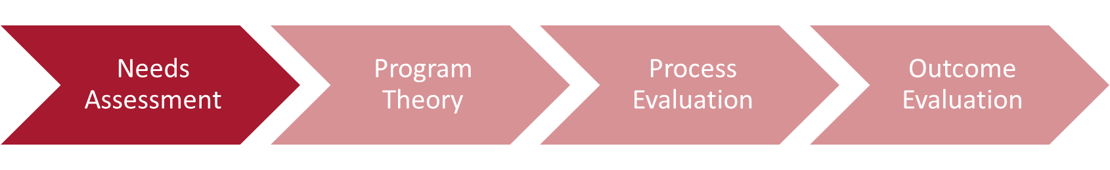
Problem Addressed
Over utilization of services
Reactive care delivery
Misaligned incentives
Fee for Service in
Primary Care
May not achieve desired outcomes
No fees for high valued services
Cannot ensure high quality services
Notes:
Miller, H. (2017)
Fee-for-service payment does not assure that the
services a patient receives are appropriate, high
quality, or achieve the results the patient needs;
Fee-for-service payment rates are often less than the
cost providers incur in delivering high-quality,
appropriate care;
There are no fees at all for many important, high-value
services; and
It is impossible for patients or payers to predict the
total cost of treating a health problem and to compare
the costs across providers.
These problems are inter-related in ways that make it
difficult or impossible to solve one without also solving
the others. A key reason that most value-based payment
and purchasing initiatives have produced disappointing
results is that they have tried to solve only a subset of
these problems without addressing the others.
United Healthcare Report - https://www.uhc.com/content/dam/uhcdotcom/en/ValueBasedCare/PDFs/VBC-Nov2016-Online-Report.pdf

Slide 10
Defining the Blueprint of the Program
Needs Assessment
Program Theory
Process Evaluation
Outcome Evaluation
Understanding the program and its components
Intended Effect of Program
Environmental scan
Notes:
There is a difference between implementation and theory
There could be a breakdown in logic at either point, which would then show where the problem would be that needs to be addressed

Slide 11
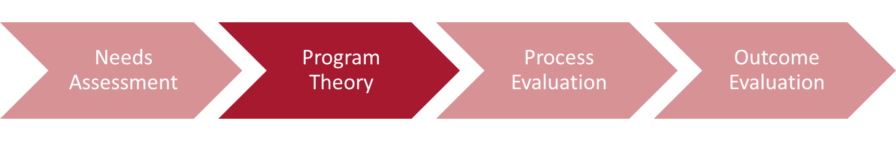

True Performance Objectives
Supporting Primary Care Physicians (PCPs) in coordinating care, managing chronic illness, and providing preventive care.
Improve Experience of Care
Improving Health of Population
Reducing Per Capita Cost of Healthcare
Based on IHI’s (Institute of Healthcare Improvement)
“Triple Aim” of healthcare improvement

Slide 12
Program Hierarchy
Reimbursement Opportunities
Reimbursement Type
Care Coordination
Lump Sum
Additional Incentives
Performance Measurement
Quality
Referral Management
Strong Medicare STARS ratings
Quality
Cost & Utilization
Indicators
Total Cost PMPM
ED Utilization
STARS Ratings
QA Score

Slide 13
Program Hierarchy
Reimbursement Opportunities
Reimbursement Type
Care Coordination
Lump Sum
Additional Incentives
Performance Measurement
Quality
Referral Management
Strong Medicare STARS ratings
Quality
Cost & Utilization
Indicators
Total Cost PMPM
ED Utilization
STARS Ratings
QA Score

Slide 14
Stakeholder Perspective
Regulatory
Highmark Insurance
Primary Care Physicians
Patients
Aligns with Medicare Plan
STARS Ratings
Better health outcomes especially for chronic illness patients
Reduce increase healthcare costs
Incentivized to focus on prevention and wellness
Incentives aligned for payers and providers to improve patient experience
Reduce preventable Emergency Department visits
Allows PCPs to improve their processes and implement best practices
Reduce readmissions and inpatient stays

Slide 15
Quality Component Logic Model
Inputs
Outputs
Outcomes
Short term
Long term
Risk Adjusted Quality Score
Emergency Department Visits
Per Member Per Month Cost
Quality Metrics
Financial Incentives
Rate
Patient Experience
Health Outcomes
Risk
Readmissions

Slide 16
Quality Metrics Overview
No. of Quality Metrics
CMS Meaningful Measurement Area
2
15
Substance Use
Management of Chronic Conditions
1
2
Preventable Healthcare Harm
Readmission to Hospitals
18
4
Appropriate Use of Healthcare
Preventive Care
Notes:
Full CMS “Meaningful Measures” data in appendix

Slide 17
Environmental Scan
The strength of evidence on the effectiveness VBP improving health delivery and patient outcomes is mixed and modest.
Many studies were over a short time frame.
Longer study period may allow better observation of long-term outcomes.
There are mixed results regarding the success of pay for performance programs; most programs show no association with lower cost outcomes and better health outcomes
Notes:
References:
Eijkenaar, Frank, Martin Emmert, Manfred Scheppach, and Oliver Schöffski. "Effects of pay for performance in health care: a systematic review of systematic reviews." Health policy 110, no. 2-3 (2013): 115-130.
Damberg CL, Sorbero ME, Lovejoy SL, et al. Measuring Success in Health Care Value-Based Purchasing Programs: Findings from an Environmental Scan, Literature Review, and Expert Panel Discussions. Rand Health Q 2014;4:9

Slide 18
Program Implementation
Needs Assessment
Program Theory
Process Evaluation
Outcome Evaluation
Reach
Recipient Perspective of Program
Implementation Fidelity – Dose Delivered and Received

Slide 19
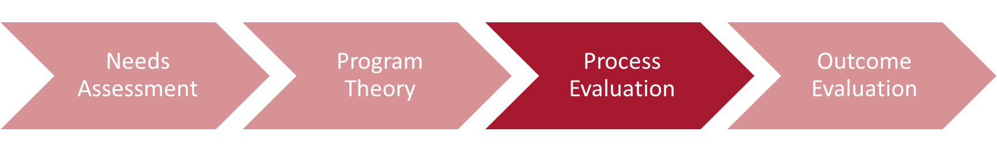
Reach & User Perspective CENTER MANJIRIIIIII
Doctors and patients in the program
Providers in program: 548
Patients in program: 1.16 million
Physician satisfaction*
“An unreasonable number of reasonable requirements”
Extent of engagement with the program
Many metrics = many interactions
Large administrative burden
Quality Metrics Details
Some metrics seem to express co-linearity,
There are some “buckets” that don’t seem to have any metrics - outcome measures, health measures
Notes:
* Low sample size

Slide 20
Reach & User Perspective
Doctors and patients in the program
Providers in program: 548
Patients in program: 1.16 million
Physician satisfaction*
“An unreasonable number of reasonable requirements”
Extent of engagement with the program
Many metrics = many interactions
Large administrative burden
Quality Metrics Details
Some metrics seem to express co-linearity,
There are some “buckets” that don’t seem to have any metrics - outcome measures, health measures
Notes:
* Low sample size

Slide 21
Aligning Theory and Design
Improve health care quality outcomes for members
Collect patient-level data to show effects on patients
Reduce annual increases in total health care costs
Collect data on non-participating providers
Patient care coordination
Create framework for patient care coordination
Population health management
Collect healthcare quality outcomes directly

Slide 22
Program Impact on Outcomes
Needs Assessment
Program Theory
Process Evaluation
Outcome Evaluation
Did the program have the intended impact?
What were the key metrics that caused the observed effect?

Slide 23
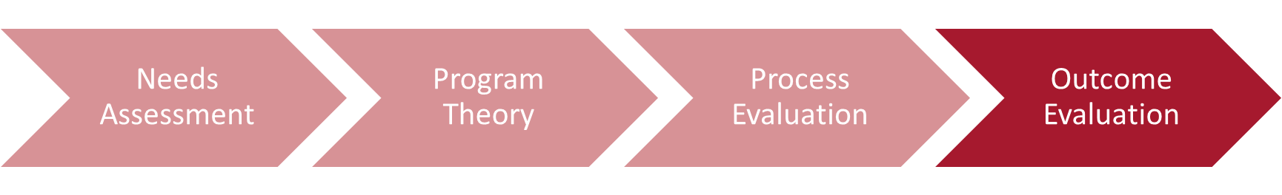
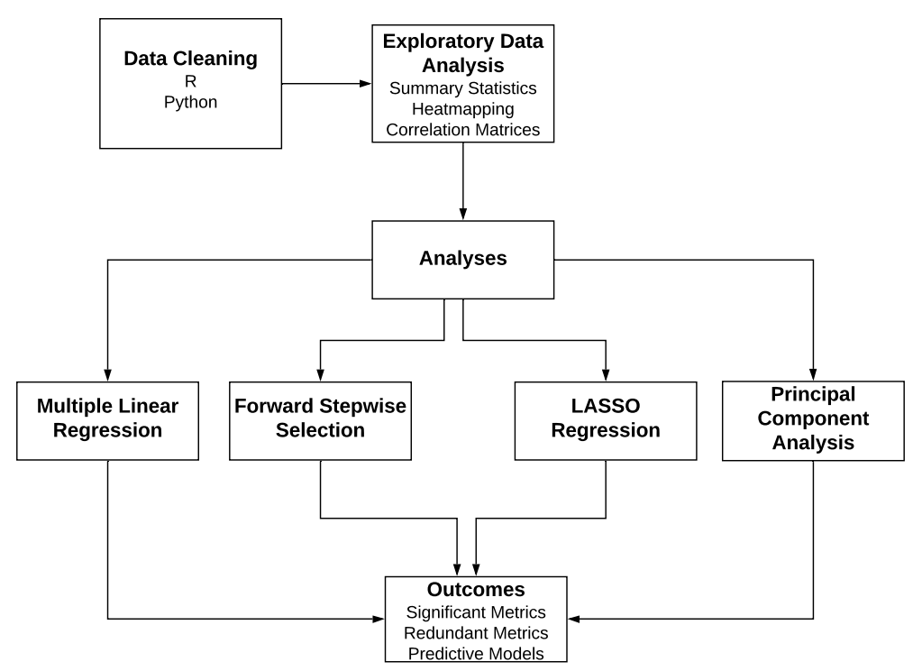
Quantitative Methods

Slide 24
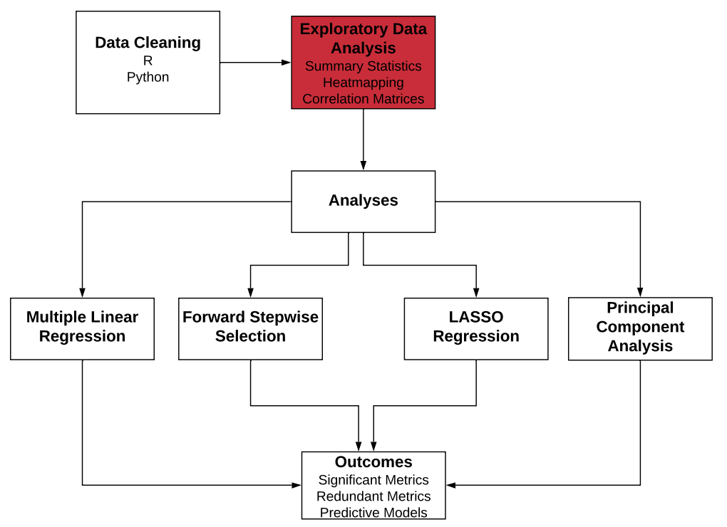
Quantitative Methods

Slide 25
Dataset Overview
38,000+ rows
Over 500 healthcare providers across 5 regions
~40 quality metrics per provider
1 year, one data point per provider per population
3 outcomes of interest:
PMPM – Per member per month cost of care
ED – Emergency department utilization
RDM – Readmission rates
3 populations: Pediatric, Adult, Senior
Notes:
We will be discussing Adult specifically, but other populations were similar

Slide 26
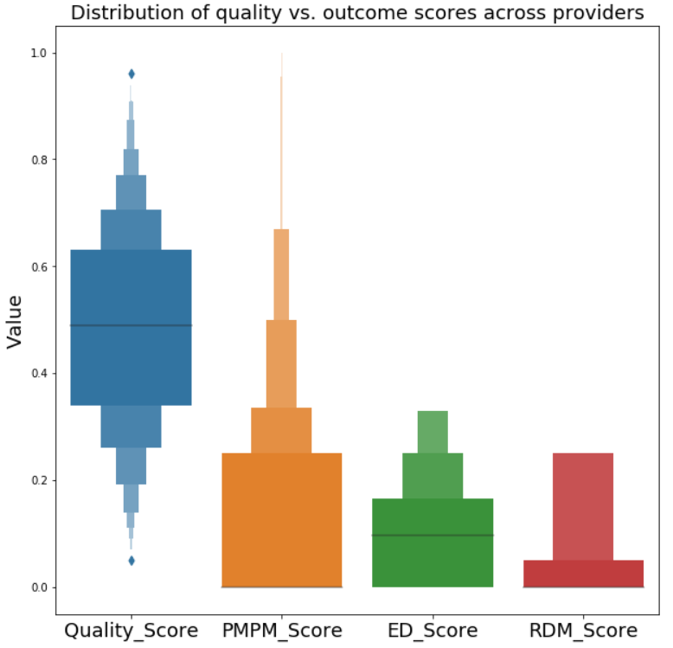
Quality and Outcomes
Distribution of quality vs outcome across providers

Slide 27
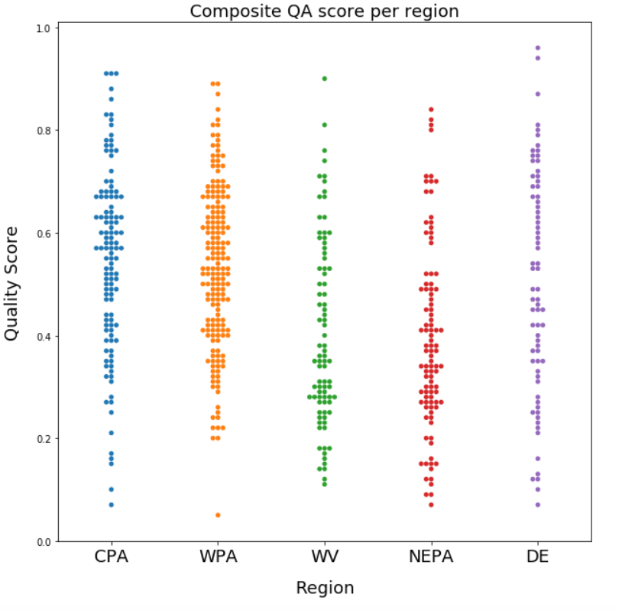
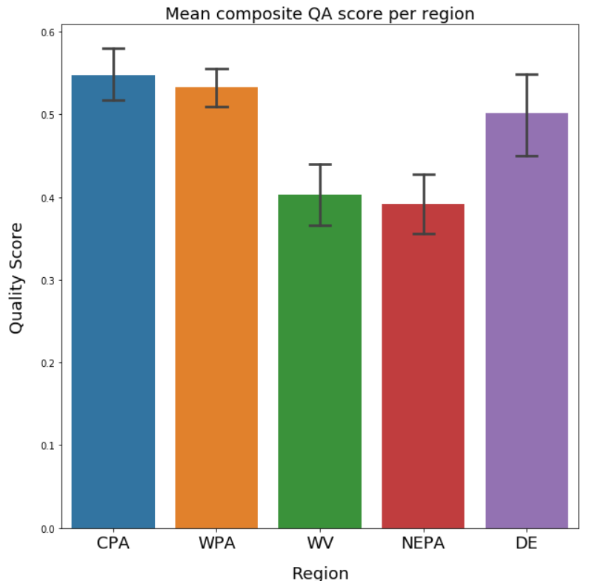
WV and NEPA have lower QA scores
Notes:
In general, kind of, the region does not seem to be affecting the scores

Slide 28
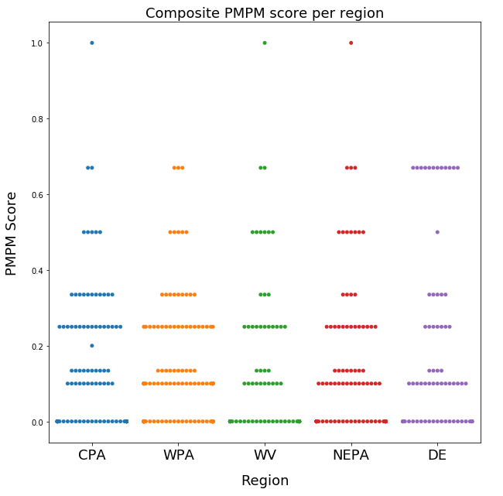
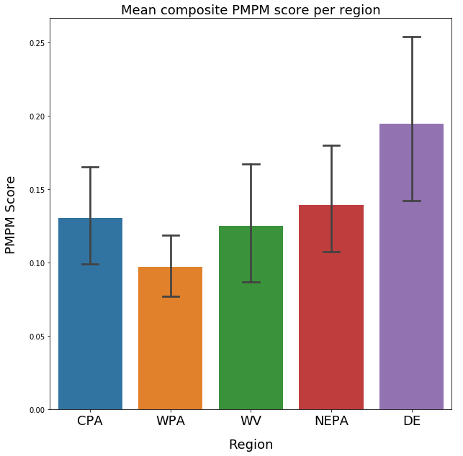
High variance in PMPM score
Notes:
This may or may not be significant

Slide 29
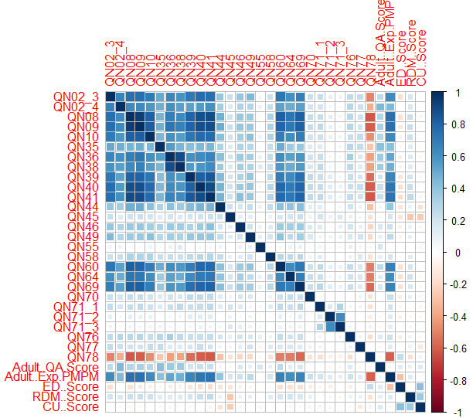
High collinearities between metrics
Most metrics were found to be highly correlated with each other
Outcomes did not show this correlation
This could lead to skewed results in a standard regression test
Lasso regression and PCA can account for this problem

Slide 30
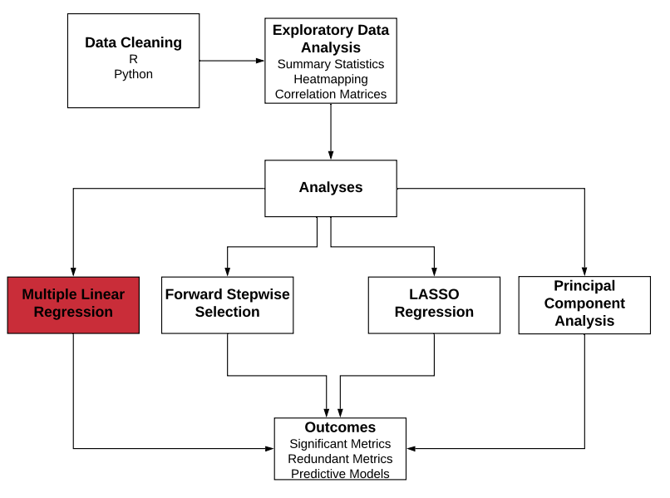
Quantitative Methods

Slide 31
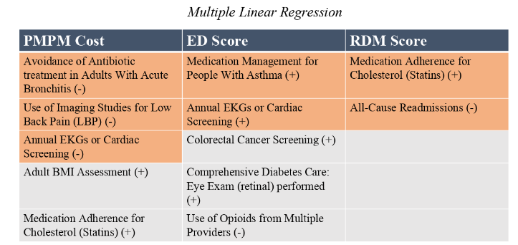

Multiple Linear Regression FIXITTTTTTT
Notes:
Low back pain as an example, statins as a counter example. Annual EKG screening did reduce ED score. Longer time to reflect cost outcomes. Talk about the metrics: Annual EKG screening and medication adherence (PMPM cost goes up and RDM goes down) made sense. All the significant ones are the STARS ratings.
Opioids should be orange and highlighted in presentation

Slide 32
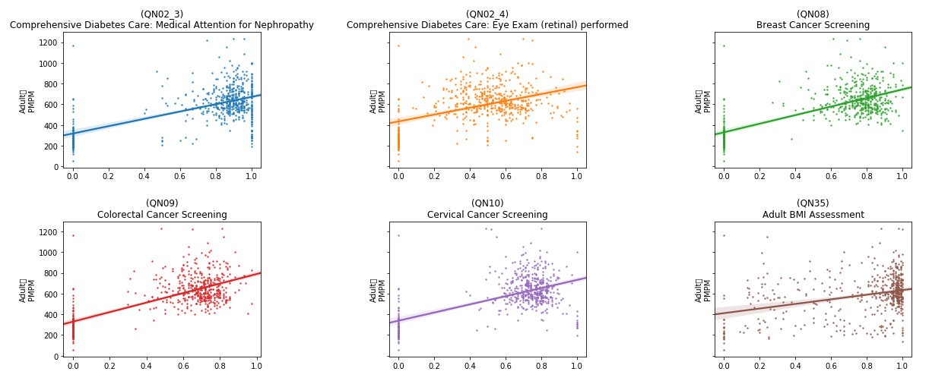
Lack of Clear Trends
Adult
PMPM
Adult
PMPM
Adult
PMPM
Adult
PMPM
Adult
PMPM
Adult
PMPM
Rate
Rate
Rate

Slide 33
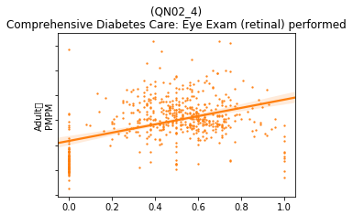
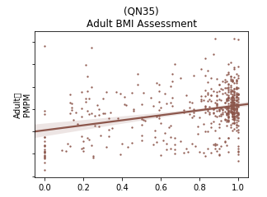
Lack of Clear Trends
Adult
PMPM
Adult
PMPM
High variability
Low confidence
Notes:
Continued data collection will make results of the program more clear/ accurate. If we had a control group would have made our life easier. There might not be linear trends but there could be clustering (control vs treatment)

Slide 34
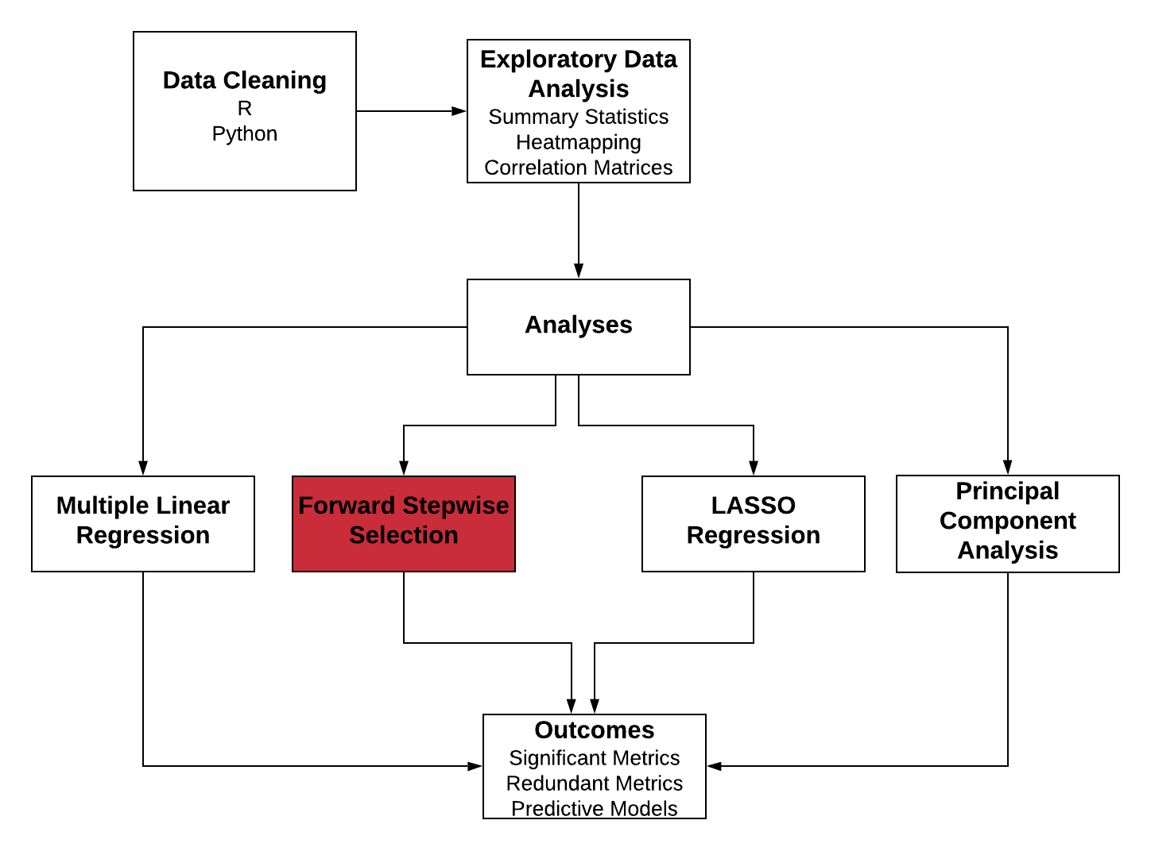
Quantitative Methods

Slide 35
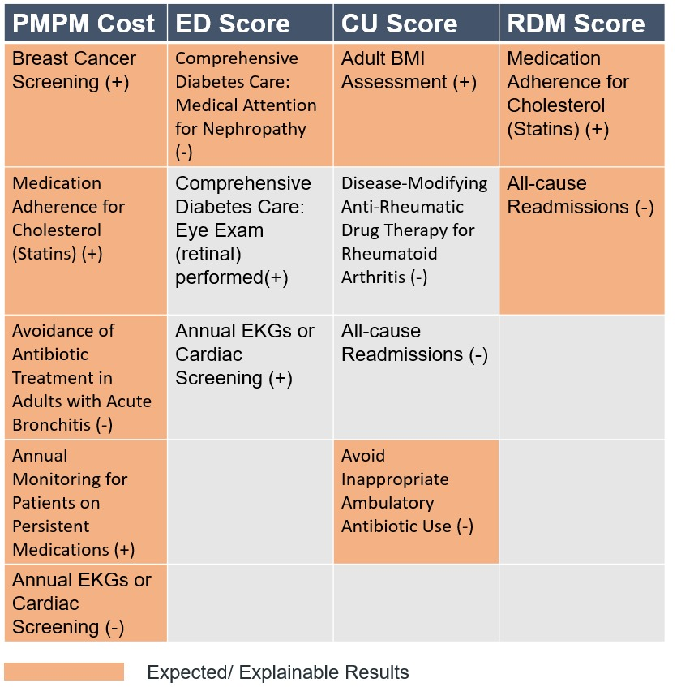
Forward Stepwise Selection (Jake)
Notes:
Medication adherence should not be orange, correlation matrix (just with breast cancer screening collinearities)
Ekg and eye exam in ED score should be orange
Breast cancer screening highly collinear with almost everything
Potential metrics to look out for

Slide 36
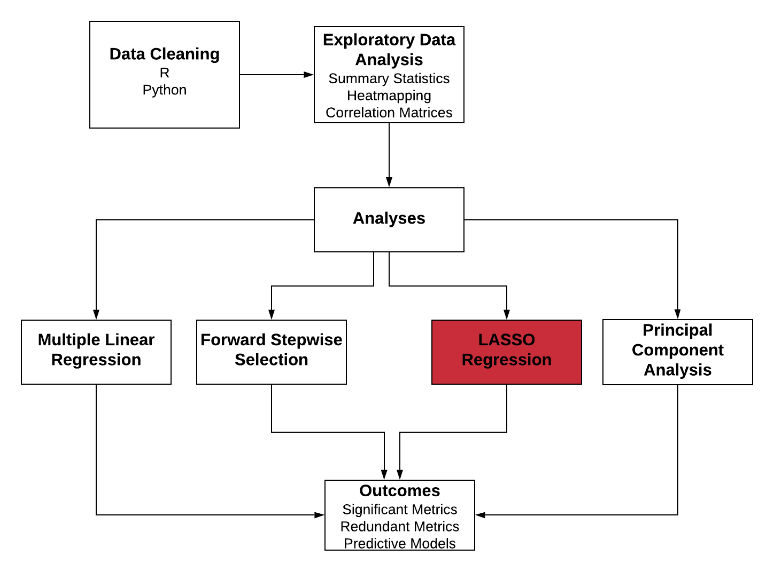
Quantitative Methods

Slide 37
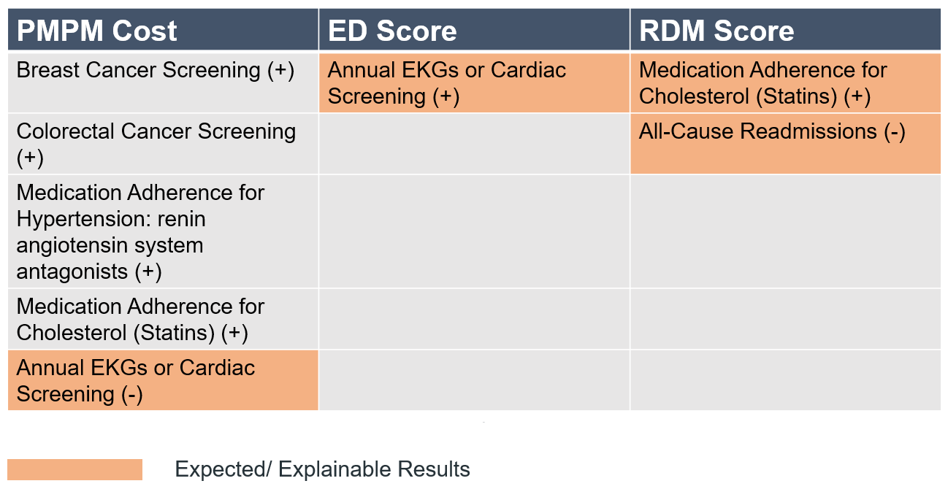
Lasso Regression
Investment in screening may yield a long-term return notwithstanding short-term cost increases.
Notes:
The quality metrics increase the PMPM cost in short term but probably drive down costs long term.
Cardiac issues are short term diseases and hence they might affect the cost sooner than breast or colorectal screening.

Slide 38
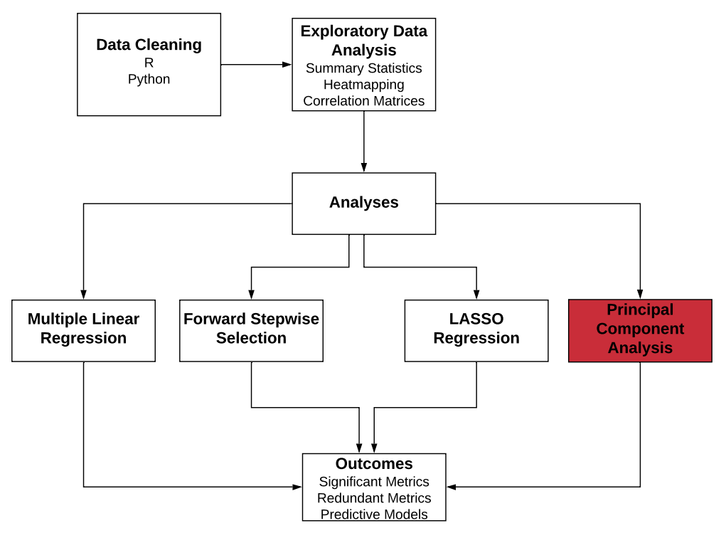
Quantitative Methods

Slide 39
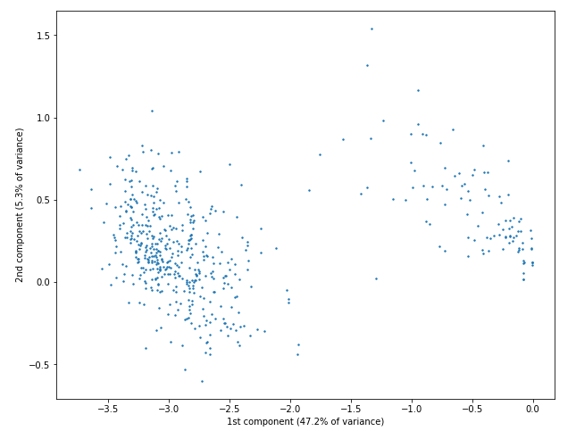
Principal Component Analysis
Top contributors to the first component, which explains 47.22% of the variance in the adult data:
QN09 - Colorectal Cancer Screening
QN08 - Breast Cancer Screening
QN41 - Drug Therapy for Rheumatoid Arthritis
QN40 - Medication Adherence for Cholesterol (Statins)
QN39 - Medication Adherence for Hypertension: RASA
Top contributors to the second component, which explains 5.3% of the variance in the adult data:
QN76 - Controlling High Blood Pressure
QN55 - Annual Monitoring for Patients on Persistent Medications
QN35 - Adult BMI Assessment

Slide 40
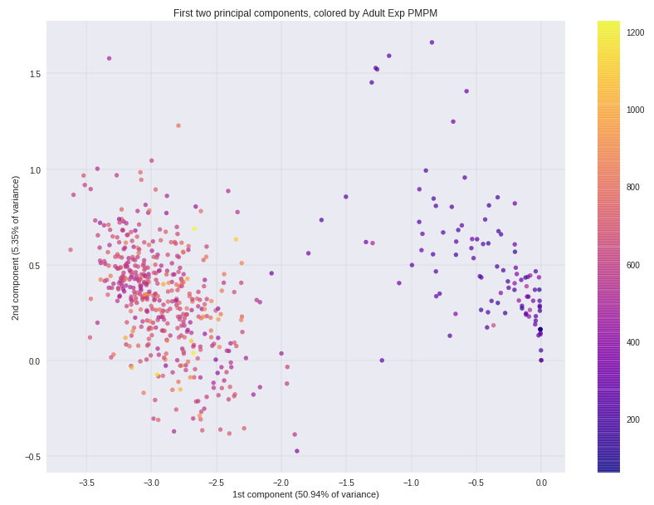
PCA reveals clusters of similar providers
First component:
QN09 – Colorectal Cancer Screening
QN08 – Breast Cancer Screening
QN41 – Drug Therapy for Rheumatoid Arthritis
QN40 – Medication Adherence for Cholesterol (Statins)
QN39 – Medication Adherence for Hypertension: RASA
QN10 – Cervical Cancer Screening
…
Notes:
Make bigger axes labels

Slide 41
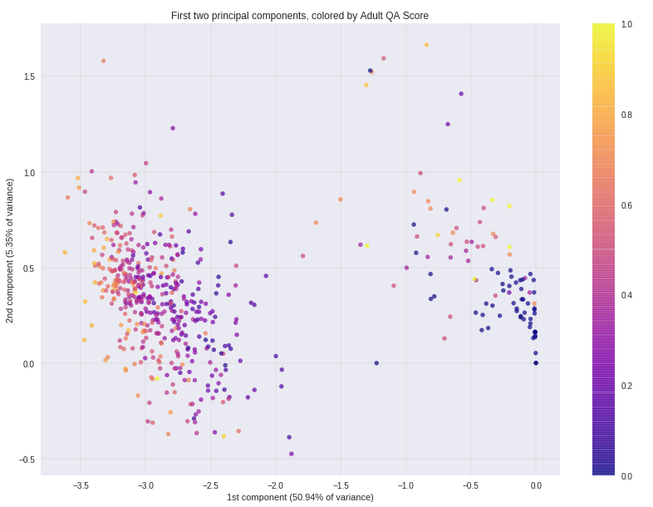
PCA reveals clusters of similar providers
PMPM Cost
QA Score
Notes:
PCA reveals potential misalignments of incentives (short term cost and utilization will increase with better quality scores)

Slide 42
Next Steps with Data
Collect data over time to enable time series analyses
Follow providers who are not participating in the program in order to study counterfactual
Focus on metrics that are highly colinear to identify potential candidates for removal
Diversify metrics across CMS-recommended “meaningful measures” areas of focus

Slide 43
Program Evaluation Framework
Needs Assessment
Program Theory
Process Evaluation
Outcome Evaluation

Slide 44
Takeaways
VBR is early in the Continuous Improvement Cycle
More closely aligned measurement
Majority of progress has been made in cost measurement
Complexity of the program inhibits physician engagement
Missing a consistent, repeatable evaluation method

Slide 45
Recommendations
Quality Metrics
Collect more data over time to enable better time-series analysis
Eliminate highly correlated metrics, they add no value & this would reduce physician fatigue
Program-Specific
Work with providers to ensure that physicians are translating feedback into process and behavioral changes
Structure incentives to elicit desirable changes
Evaluation of the Program
Measure outcomes related to health and patient experience
Assess the causal effect of the program using a control group
Gather patient-level data in order to understand how the program is affecting patients, not just providers and payor

Slide 46
Questions?

Slide 47
Appendix

Slide 48
Program Evaluation Framework
Context for Evaluation (Stage 0)
What is the purpose of the evaluation?
Formative evaluation (primary purpose is to analyze the program to improve and strengthen it). To some extent outcome evaluation.
Since the True performance program has been implemented only for about 2 years now, we cannot really say for sure if it has achieved its outcome or not.
The main purpose of the evaluation is to evaluate the cost outcomes (impact evaluation)
Who are the stakeholders involved?
Highmark Inc Data Science team
Highmark Inc Value Based Reimbursement team
Highmark Inc Providers in their network (PCPs)
Patients
What are the limitations and constraints of this evaluation?
Limitations: Lack of comprehensive time-series data, lack of a mechanism to collect health outcomes and patient experience outcomes.
Constraints: Time duration for evaluation
Needs Assessment (Stage 1) ( will focus on the issue of over utilization and low quality)
What is the problem that the program is trying to address?
Misalignment of incentives between payer, provider, patients
Healthcare incentives not aligned with healthcare value
Issues with primary care within the United States
What is the extent of the problem?
Increased amount of spending on healthcare is not reflecting in the health or quality outcomes
Add details about the numbers related to healthcare spending and outcomes compared to other countries
Who or what is the target population?
Physicians, patients (to a lesser extent)
Program Theory (Stage 2) ( structure of the program, research on other VBR programs)
What is the True Performance Program? (create a logic model)
How are the outcomes measured? (impact theory)
How were the quality metrics in the program selected?
How should the quality metrics be measured?
How does the program engage providers/ physicians in improving their quality scores?
Do the measurement of quality metrics improve the outcomes? (In theory)
Process Evaluation (Stage 3) (qualitative analysis of interviews with physicians)
Are participants satisfied with the program? (Satisfaction)
How many providers/ persons are part of the program? (Reach)
Extent to which the program was implemented consistently with underlying theory/ design/ philosophy. (fidelity of program)
Extent to which participants actively engage with program (dose received)
Amount of each component delivered/ details about quality metrics? (dose delivered)
Outcome Evaluation (Stage 4) (data analysis of the quality metrics)
Define the counterfactual (outcomes in the absence of the program)
What could be the potential confounders/selection bias?
Program effects (Quantitative results)
Difference in outcomes between regions, patient groups, providers
Which measures contribute most to the cost outcome?
Recommendations (Stage 5)
Spending + quality + infrastructure support
Increase the share of provider reimbursements tied to VBR to incentivize organizational changes
Build stronger payer + provider relationships
Align measures across different payer contracts (to reduce the burden of data collection)
Better align individual physician incentives with VBR contract incentives

Slide 49
References
United Healthcare Report - https://www.uhc.com/content/dam/uhcdotcom/en/ValueBasedCare/PDFs/VBC-Nov2016-Online-Report.pdf
Program Eval Book
Stars Ratings Guide
Miller, H. (2017) Why Value Based Purchasing Isn’t Working and How to Fix it
Eijkenaar, Frank, Martin Emmert, Manfred Scheppach, and Oliver Schöffski. "Effects of pay for performance in health care: a systematic review of systematic reviews." Health policy 110, no. 2-3 (2013): 115-130.
Damberg CL, Sorbero ME, Lovejoy SL, et al. Measuring Success in Health Care Value-Based Purchasing Programs: Findings from an Environmental Scan, Literature Review, and Expert Panel Discussions. Rand Health Q 2014;4:9
CMS Meaningful Measures guide

